Slide 1

Gooseplayer A music player for DnD & Data Enthusiasts & Local Music Server Streaming
Joshua Anderson
&
Camillus Settanni

Slide 2
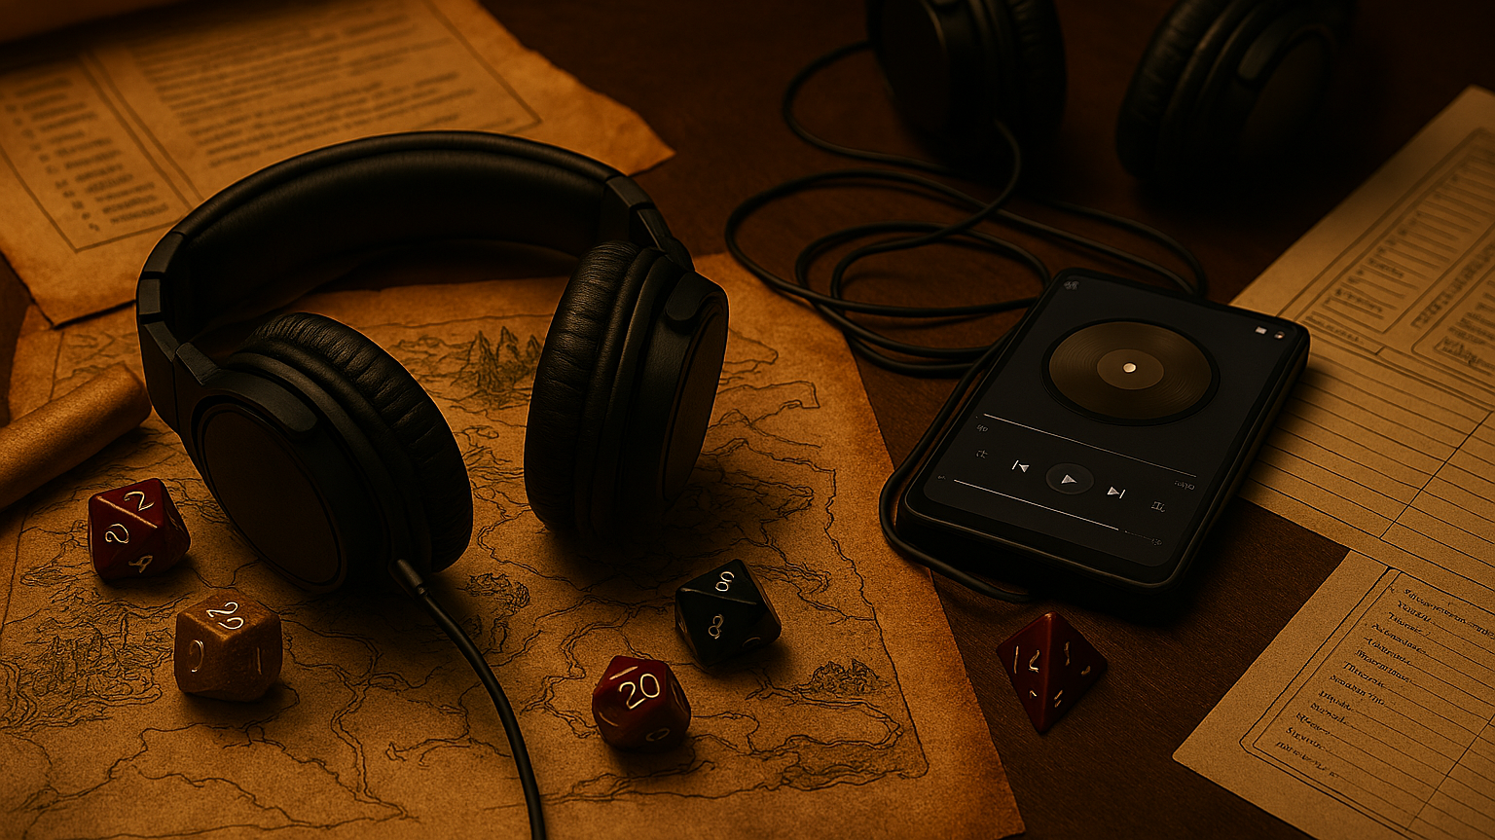
What is GoosePlayer?
GoosePlayer is a Windows computer desktop application that allows for multiple music tracks to be played in conjunction with each other, allowing for a much more immersive environment when playing table-top games such as DnD. GoosePlayer also allows for connection to a remote music server giving users the ability to stream their audio remotely through the player.

Slide 3
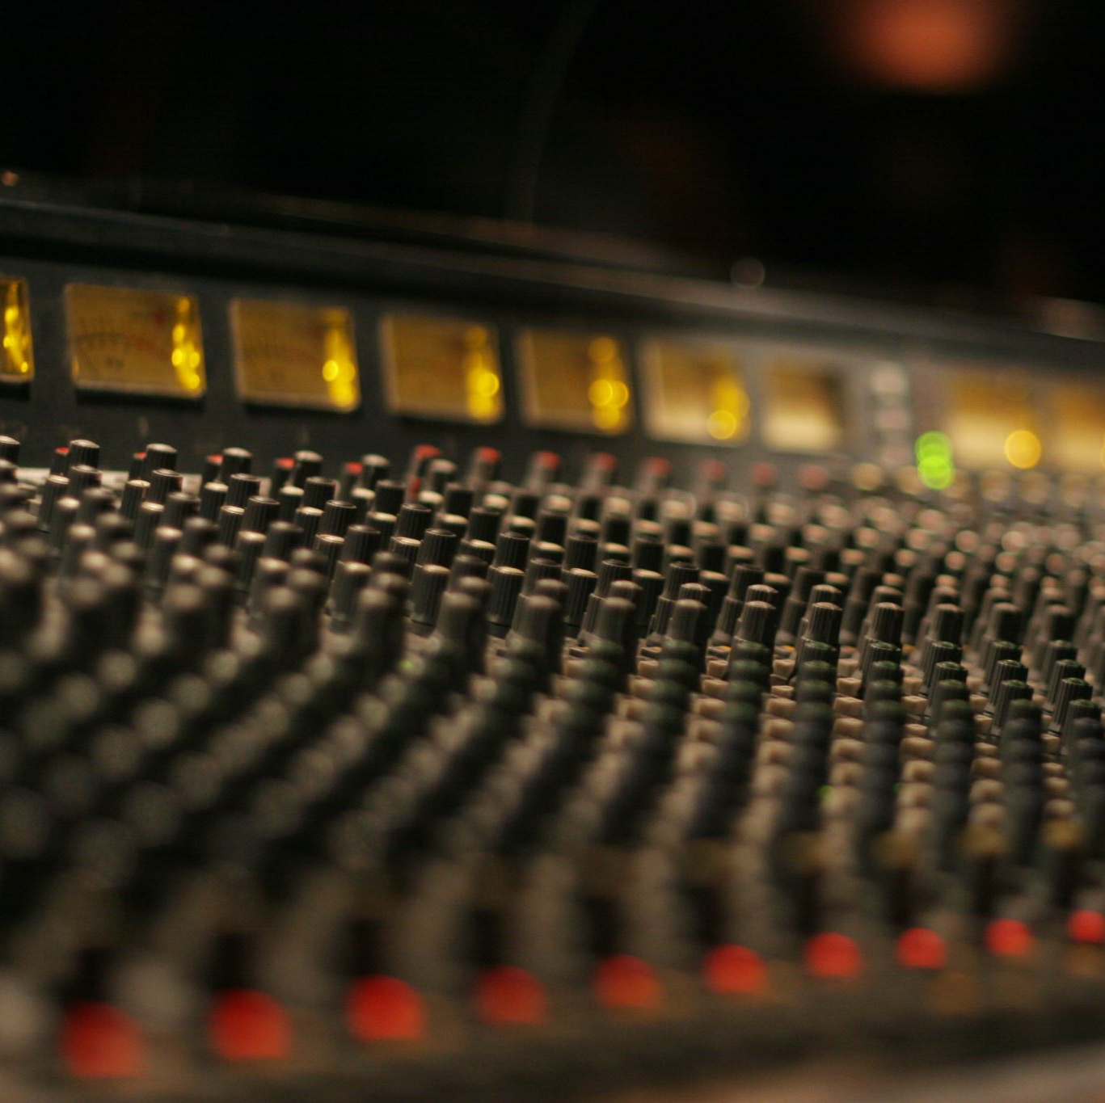
Why Gooseplayer?
This music player was born out of a mix of reasons.
Desired to code an advanced desktop application for Windows that implemented concepts such as queuing for files and used advanced coding tools and features available in Java
Lack of music players available that were capable of simultaneously playing multiple tracks for DnD sessions
Wanted features to better suite data collecting enthusiasts, functioning as an audio multitool (player + multiplayer + radio).

Slide 4
Implementation Approach
Agile/Scrum with 1-week sprints
Weekly progress reviews and sprint planning with Dr. Sun –focus on backlog, features, and testing

Slide 5
Analysis

Slide 6

Functional Requirements
Core Features
Playback Modes
View modes
User Experience
Technical

Slide 7
GoosePlayer System Requirements & Features
Core Features
Play, Pause, Stop Skip (Next) / Previous Seek (clickable progress bar) Volume control Clear queue Support MP3, WAV, FLAC audio formats Multiple independent player instances Online streaming
Playback Modes
Repeat Off / Repeat One / Repeat All Shuffle Queue & Playlist Management
Drag-and-drop files & folders into queue Remove selected song(s)
Load / delete / rename playlists
“Add to queue” vs “Play now” context menu
View modes:
Display song title, artist, album, year, genre Show embedded or folder album art Default “missing art” placeholder
User Experience Optional Visual themes Remember window size/position and last playlist in queue
Technical
Windows desktop application

Slide 8
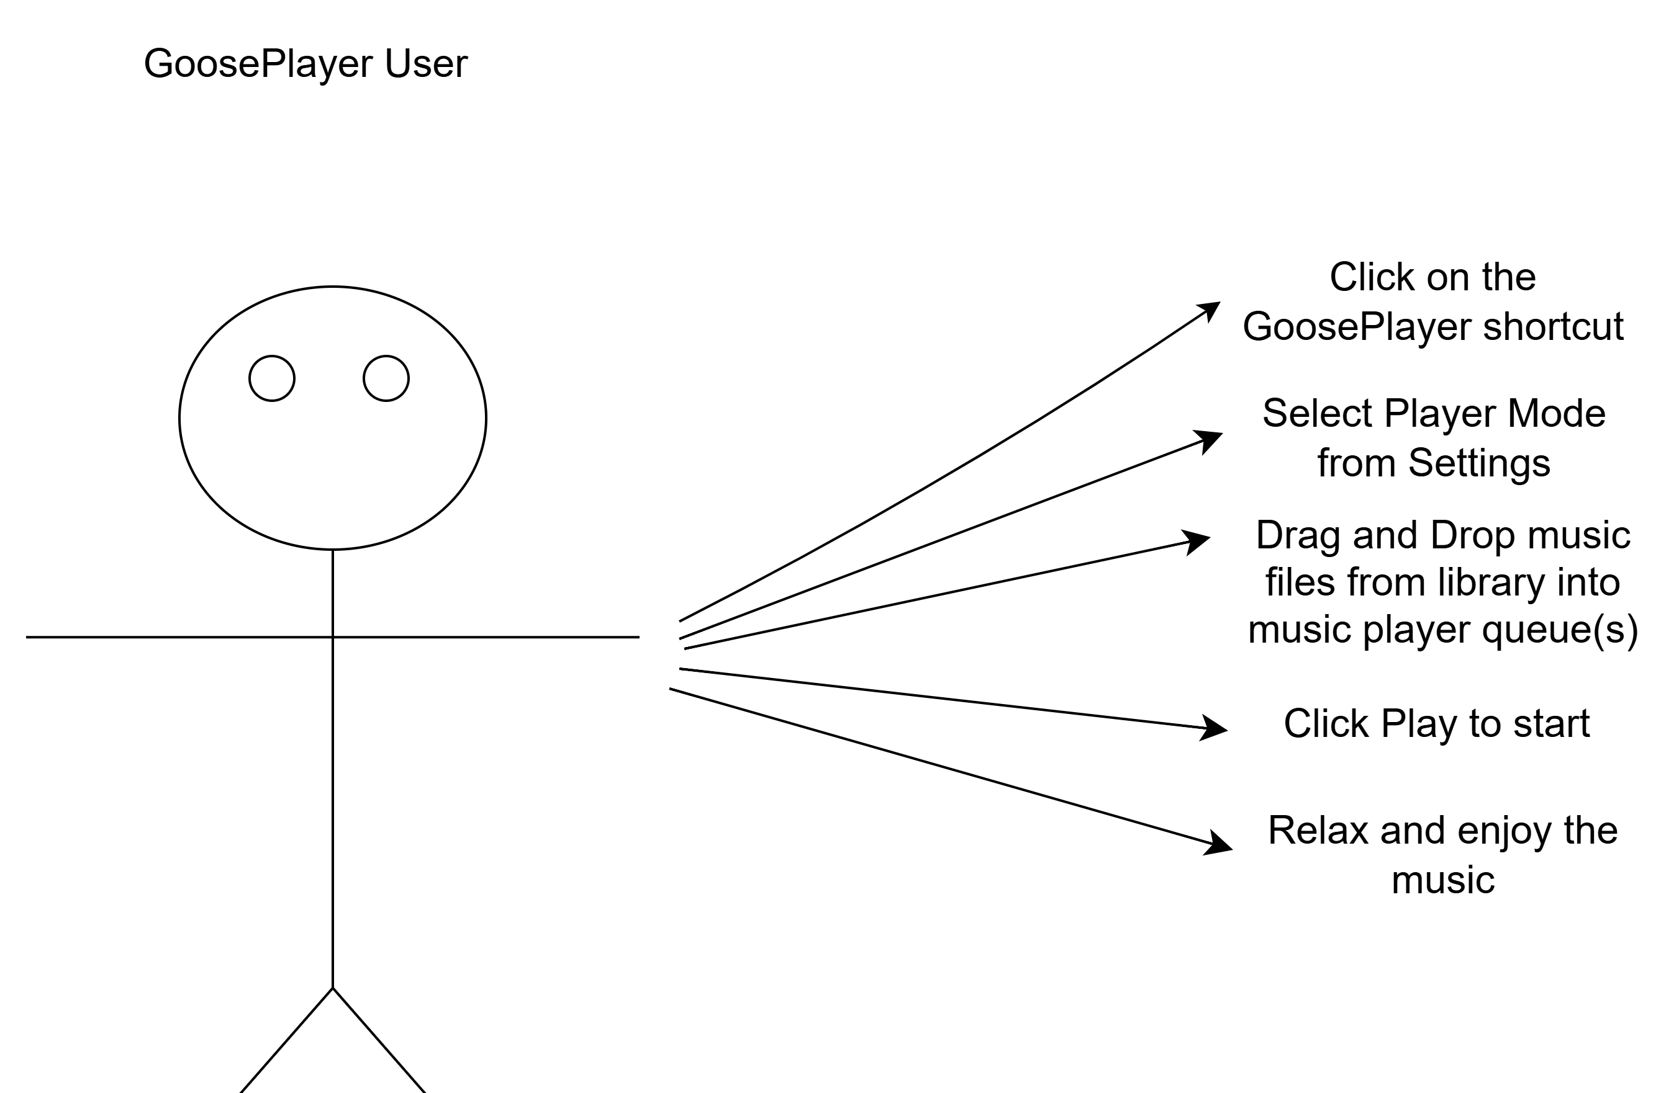
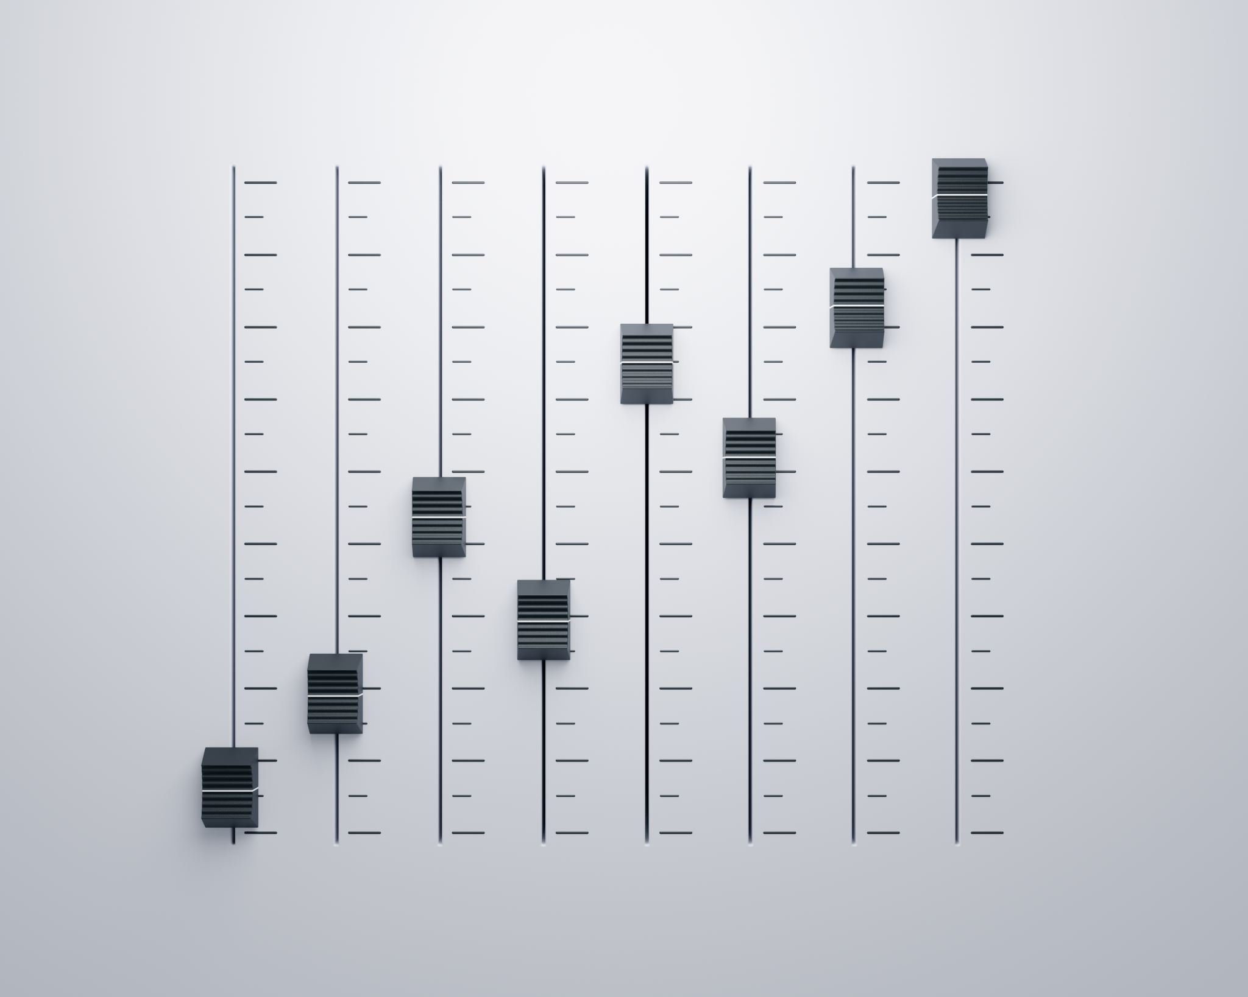
User Experience Requirements
The typical user of this application should be able to click on the shortcut to open the player, choose the mode of the player they wish to utilize under settings, and drag and drop music files they wish to play into the queue for the player or type in the address for the online music stream.

Slide 9
Implemetation

Slide 10

Tools/Technology Used for this Project
Language
Project Management/ Communication
Version Control
Grok
Copilot
IDE
Build Tool
Java
Apache Maven
VS Code
Git
Github
Discord
Jira
AI assistance
ChatGPT
Diagram Software
Draw.io

Slide 11
Process Model
Incremental Model

Slide 12
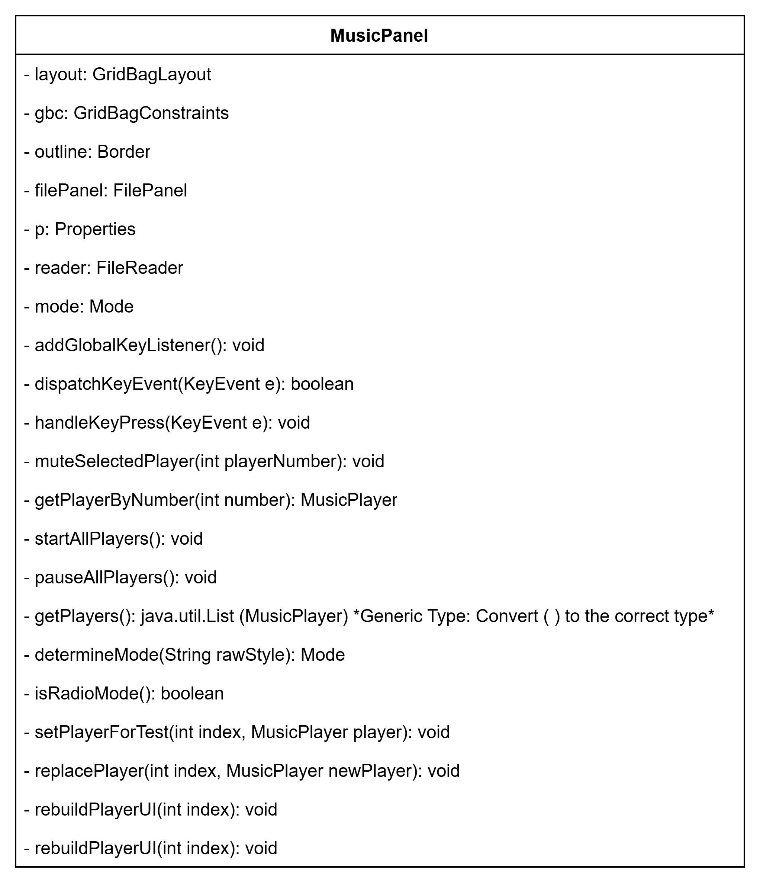
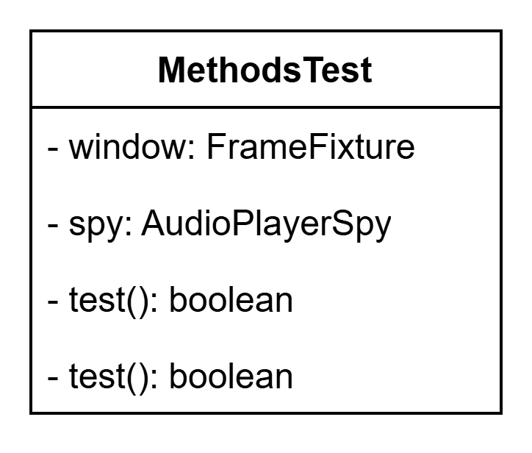
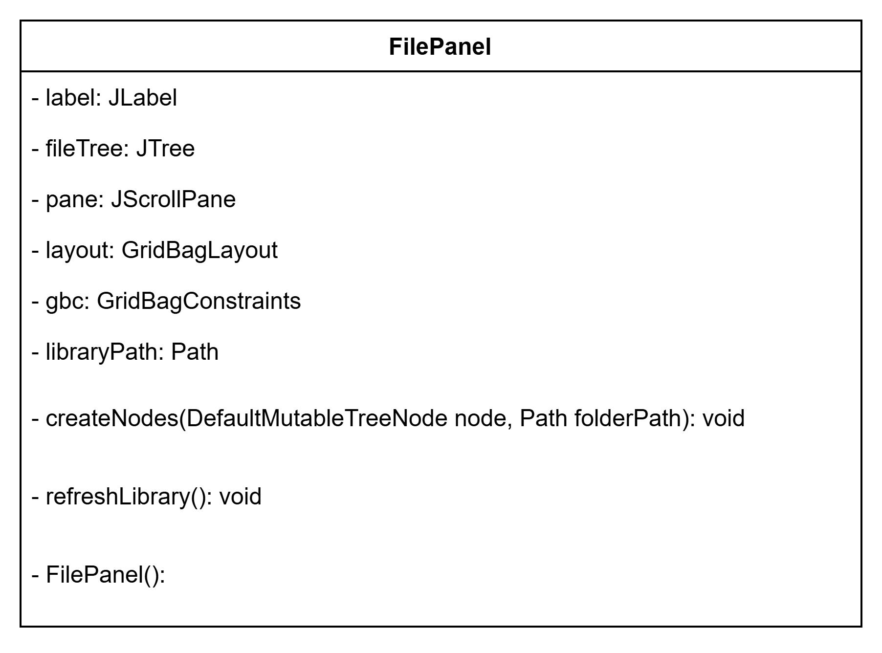
More Diagrams

Slide 13
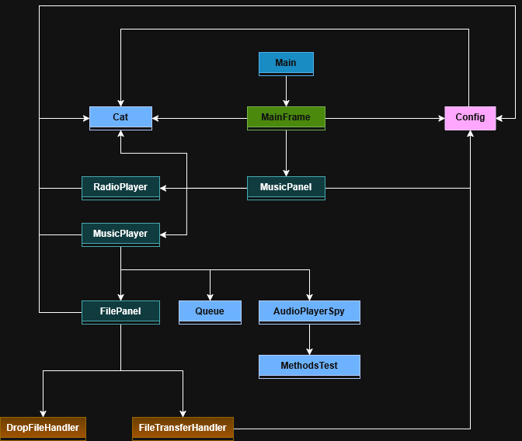
Hierarchical Design

Slide 14

Testing

Slide 15
Testing Tools Used
JUnit 5
Main assertion and testing framework
Mockito
Mocking framework for Java
AssertJ swing (tokyo.northside fork)
UI testing component

Slide 16
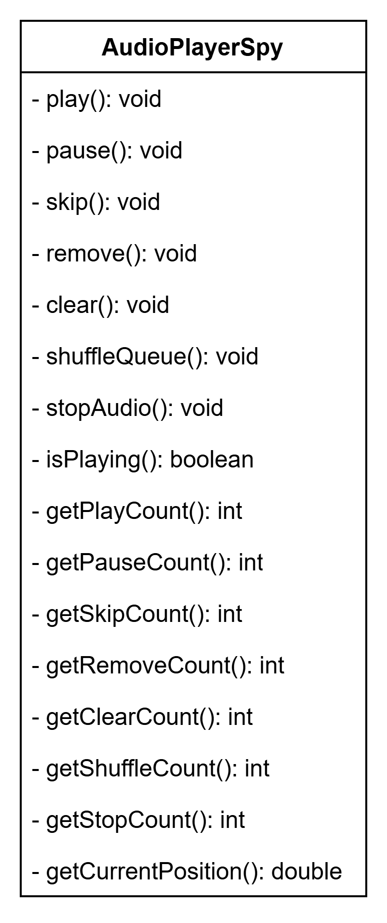
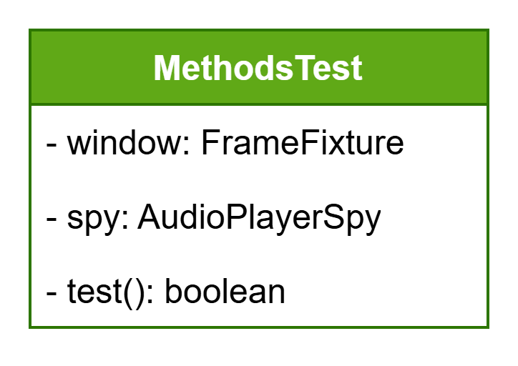

Slide 17
Test Cases
Mix of manual and automated regression testing
Regression Testing
- Methods being called correctly
- Correctly functioning when called
- UI interactions
- Queue interactions

Slide 18

Demo

Slide 19
Project Challenges
Plugin Support
Testing Software

Slide 20

Future Features for Implementation

Slide 21

Questions?

